Slide 2
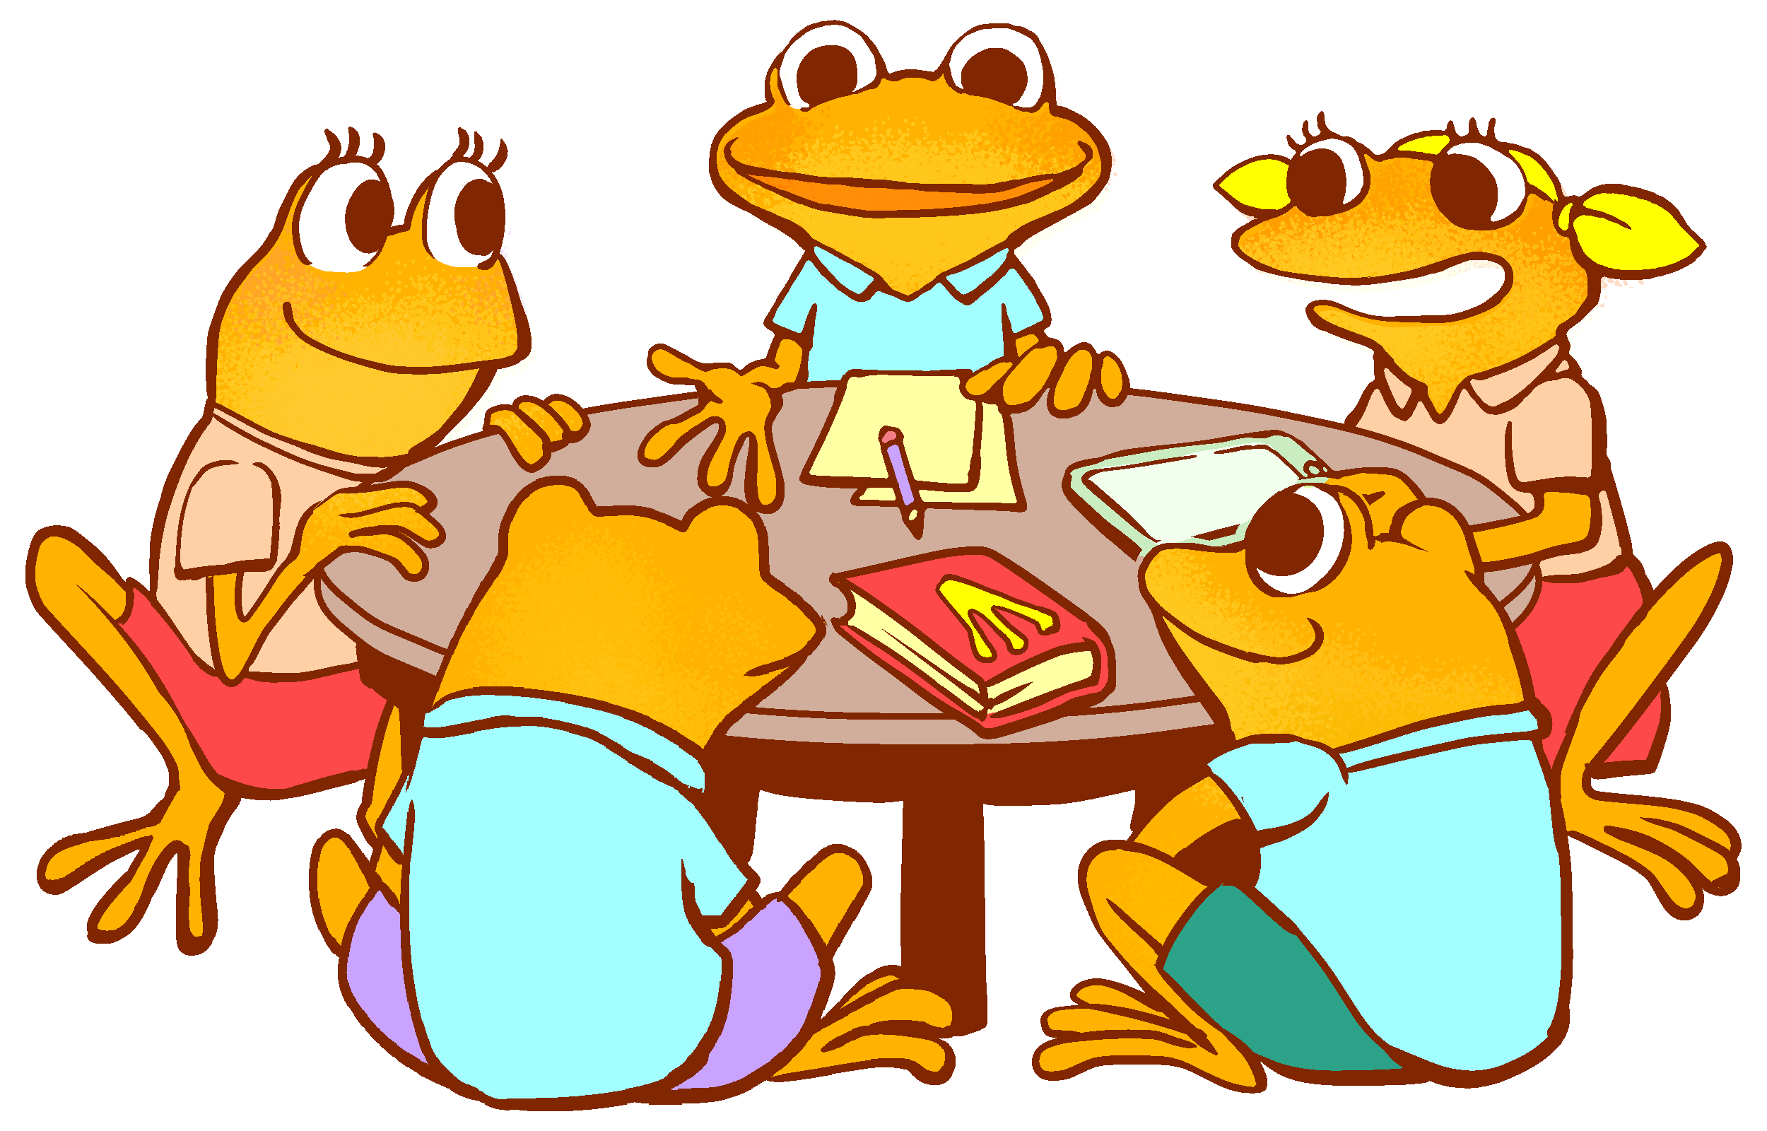
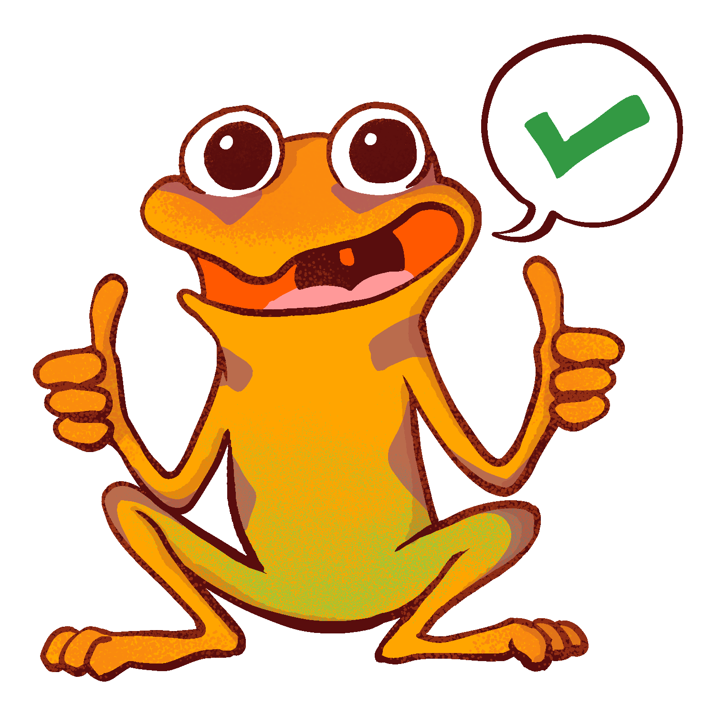
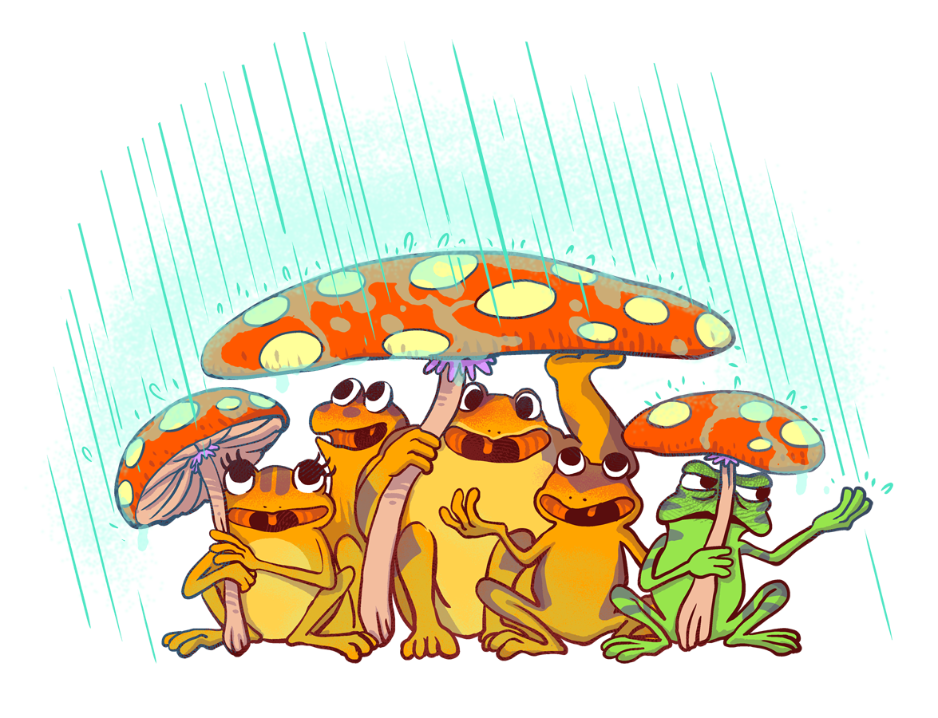
The Orange Frog
P 1
Learning Objective:
I can read/listen to the Orange Frog Comic.
I will discuss the central theme of the Orange Frog and will discover connections for my everyday life.
Notes:
Standard:
Essential Concept: Communicate and work productively with others emphasizing collaboration and cultural awareness to produce quality work.
Skill:
Interact positively as a team member.
Cooperate with others in a group setting.
Generate ideas with group members.
Are active listeners.
Read and understand information in a variety of forms.
Express ideas.

Slide 3
Skills
Interact positively as a team member.
Cooperate with others in a group setting.
Generate ideas with group members.
Are active listeners**
Read and understand information in a variety of forms.
Express ideas**

Slide 4
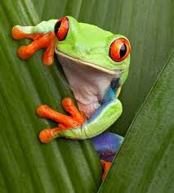
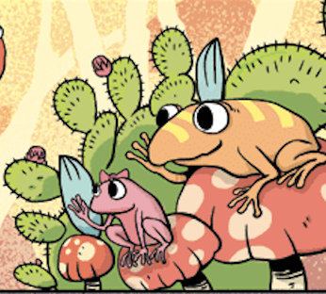
Questions
“When you hear the word positive, what do you think of?”
“What do you know about Frogs? Are they happy amphibians? Do amphibians have emotions?”
“Has anyone read the Orange Frog?”
Notes:
Facilitate discussion with students. When they seem to be wrapping it up, tell them, “We are going to read a Comic about a VERY interesting frog named Spark.
Spark is going to teach us some important skills. We will also be introduced to some of his friends.

Slide 5
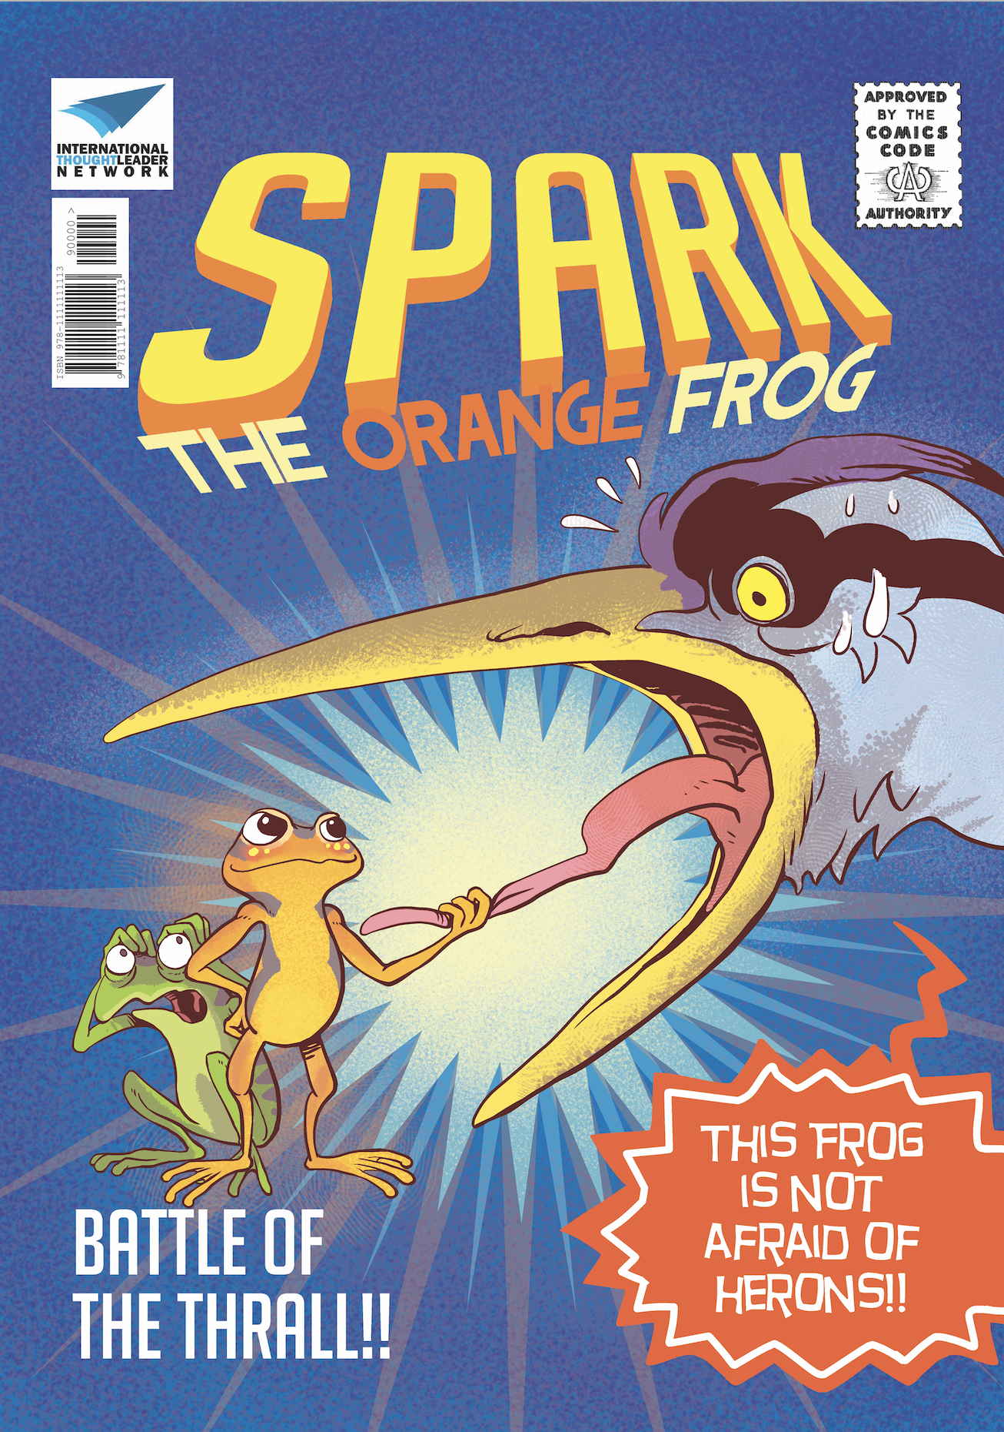
Introducing The Orange Frog

Slide 6
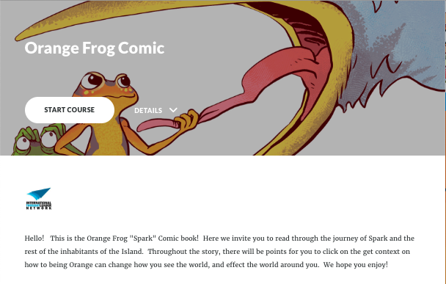
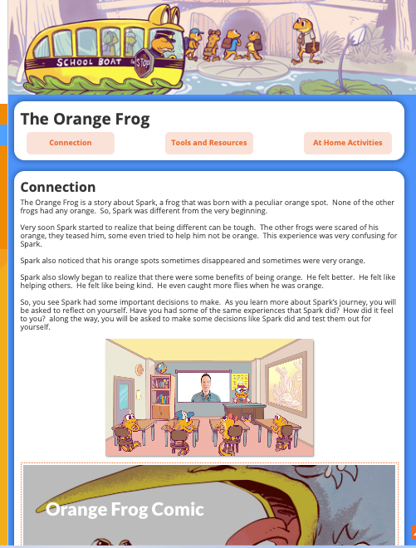
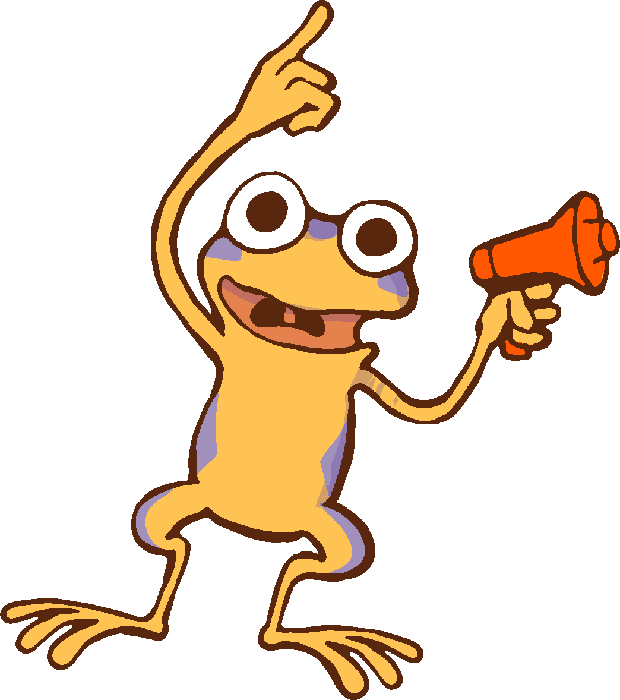
Finding the Orange Frog Comic
All Right!
Let’s Read Pages 1-11
Notes:
Read intro aloud to students.
Hello! This is the Orange Frog "Spark" Comic book! Here we invite you to read through the journey of Spark and the rest of the inhabitants of the Island. Throughout the story, there will be points for you to click on the get context on how to being Orange can change how you see the world, and effect the world around you. We hope you enjoy!

Slide 7
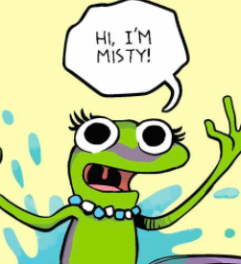
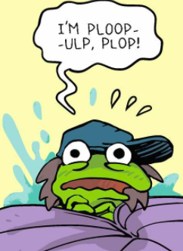
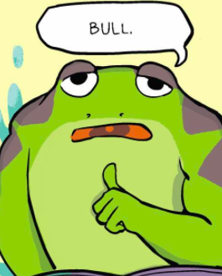
Thoughts
Misty | Plop | Bull
“Fun loving, free spirit | “Nervous, scared, anxious | Working, ignoring social interactions
Misty Thinks | Plop Thinks | Bull thinks
Notes:
“When I hear the word positive, I think of “good”. Good things are considered positive. So, if my dog does a good job of sitting, when I give him a treat, that seems like a positive thing. Positive is a (thumbs up). When I give you this sign (thumbs up) that means that you are doing something good, or right.
In the early parts of the Orange Frog, we hear about 3 very important Frogs, Misty, Plop and Bull. Misty seems to be a bit of a fun frog. Plop seems to be a bit of a nervous frog. Bull is super different. He is a work-a-holic. He is building himself a house when we meet him in the story”.
Briefly discuss the differences between the three frogs. Ask students what they recall. Ask the students to look at the pictures of the frogs.
“Based on the pictures, what can they decide is different? Social Cues, looks, mannerisms, etc”.
“What do the frogs have in common, if anything? They seem so different”.
“Can anyone relate to any of these frogs? Misty’s “LET’S HAVE FUN” personality, Plop’s anxiety?”

Slide 8
Actions
Talk to your elbow partner and tell your partner which frog you feel most like…
… and say why you feel like that frog
Notes:
Action:
Ask the students to have an elbow partner discussion -- “What frog are you like? When I think about the frogs, I think about their traits. I think about the things they have said (reference chart). I am most like _______, because ___________”.
**Example: “I am most like Bull, because I am the type of person that works every second of every day. I like to make sure all of my work is done and done correctly. I don’t care much about having fun”.
When students have shared ask for some examples. Conclude gaining agreement that we know others who are like these types of frogs everyday. These are not bad frogs, but maybe just not living up to their potential. All frogs (and people) can be Orange like Spark.

Slide 9
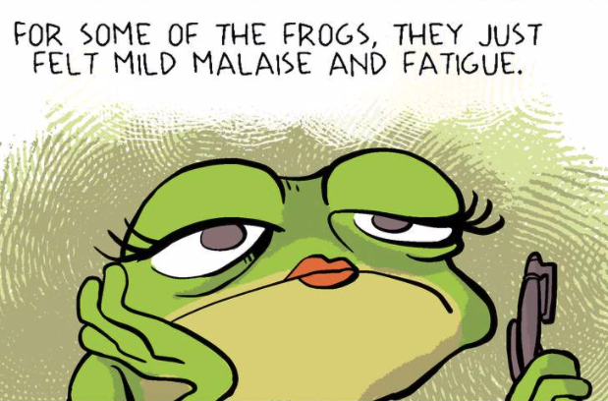
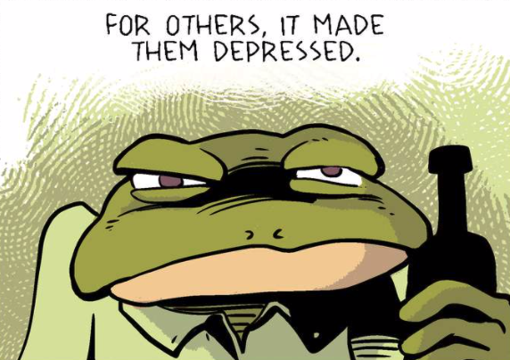
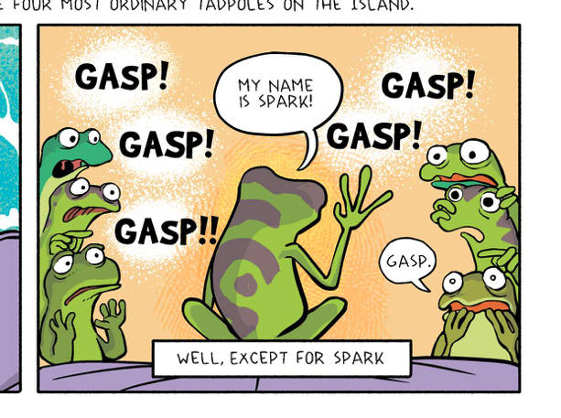
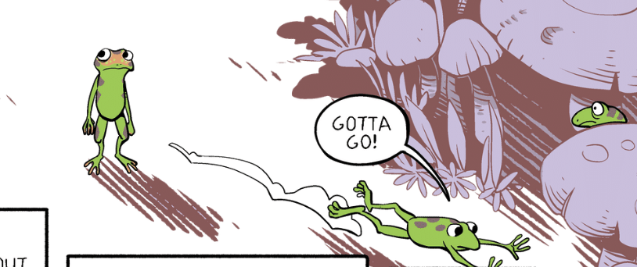
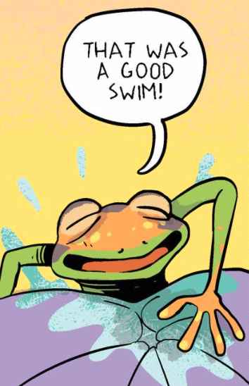
BONUS
What is the Thrall in the “real world”?
Based on the reaction of others, is being Orange a good thing? Is it “normal”?
What is Misty’s solution to Spark’s “problem”? Was she being mean?
On Page 7, Spark looks defeated about his decision to maintain a green complexion. Do you think he felt good about his choice? What emotions do you think he is experiencing?
Why do you think Spark turned more orange on Page 8, when he goes swimming? Why does this help him to feel “good”?
Notes:
The Thrall is the malaise we experience when we believe our thoughts and actions will not make a difference.
Normal is fitting in, or a green appearance.
Misty’s solution – “You could cover yourself with moss,” and attempt to fit in. Misty was trying to be helpful.
Facilitate discussion – What does Spark’s defeated look say about the difficulty of being Orange? Is it easier to be green? Spark turns Orange when he engages in the activities he loves – particularly exercise, like swimming.

